Slide 1

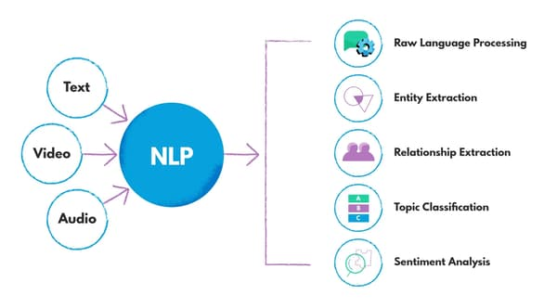

UNIT_1_Introduction to NLP
Presented by:
Dr. G. S. Bhavekar
B.E, M.E, Ph.D. (VIT Vellore) Silver Medalist
Associate Professor
AI&DS Engineering
CSMSS CSCOE

Slide 2
Unit 2: Language Models and Vector Semantics
N-gram models,
Language model evaluation,
Smoothing techniques,
Information Retrieval,
Vector space models,
Term frequency-inverse document frequency (TF-IDF),
Pointwise Mutual Information,
Applications of the TF-IDF or PPMI vector models,
Word2vec, Relevance ranking algorithms.

Slide 3
N-gram models

Slide 4
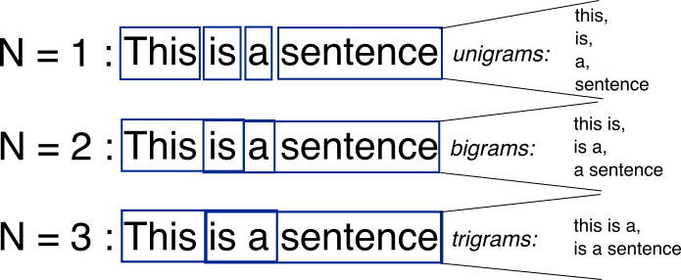
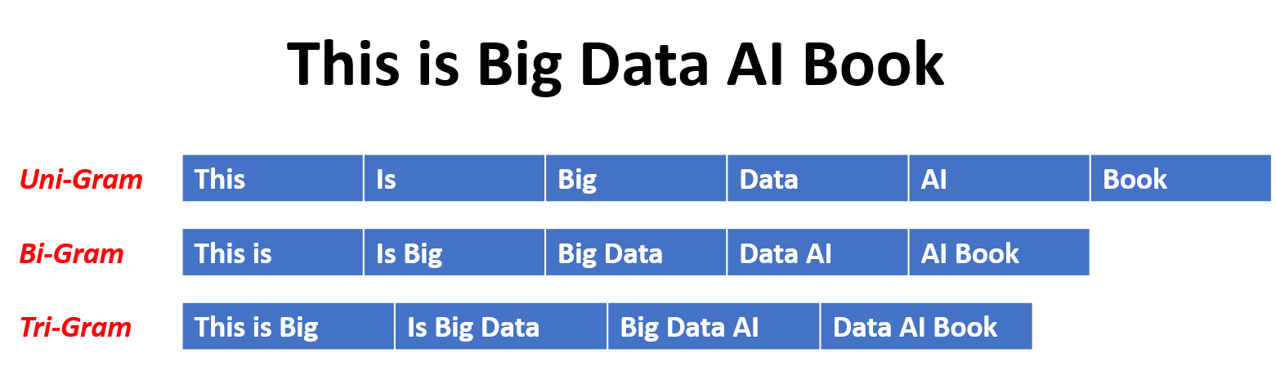

Slide 5
Language modeling is the way of determining the probability of any sequence of words. Language modeling is used in a wide variety of applications such as Speech Recognition, Spam filtering, etc. In fact, language modeling is the key aim behind the implementation of many state-of-the-art Natural Language Processing models.
Methods of Language Modelings:
Two types of Language Modelings:
Statistical Language Modelings: Statistical Language Modeling, or Language Modeling, is the development of probabilistic models that are able to predict the next word in the sequence given the words that precede. Examples such as N-gram language modeling.
Neural Language Modelings: Neural network methods are achieving better results than classical methods both on standalone language models and when models are incorporated into larger models on challenging tasks like speech recognition and machine translation. A way of performing a neural language model is through word embeddings.

Slide 6
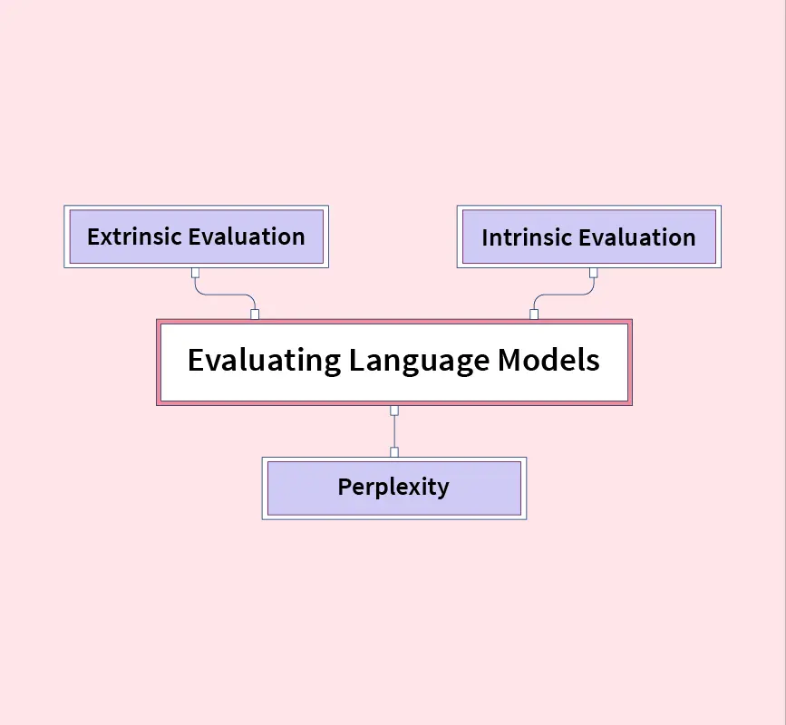
Language model evaluation
Extrinsic Evaluation
Extrinsic evaluation is the best way to evaluate the performance of a language model by embedding it in an application and measuring how much the application improves.
It is an end-to-end evaluation where we can understand if a particular improvement in a component is really going to help the task at hand.
Example: For speech recognition, we can compare the performance of two language models by running the speech recognizer twice, once with each language model, and seeing which gives the more accurate transcription.

Slide 7
Intrinsic Evaluation
We need to take advantage of intrinsic measures because running big language models in NLP systems end-to-end is often very expensive, and it is easier to have a metric that can be used to quickly evaluate potential improvements in a language model.
Perplexity
Perplexity is a very common method to evaluate the language model on some held-out data. It is a measure of how well a probability model predicts a sample.
The Intuition
The basic intuition is that the higher the perplexity measure is, the better the language model is at modeling unseen sentences.
Calculating Perplexity
Perplexity of a probability model like language models in NLP: For a model of an unknown probability distribution, and a proposed probability model, we can evaluate perplexity

Slide 8
Entropy
Entropy is a metric that has been used to quantify the randomness of a process in many fields and compare worldwide languages, specifically in computational linguistics.
Handling Unknown Words
Tokenizers in Language Models: Tokenization is the first and important step in any NLP pipeline, especially for language models which break unstructured data and natural language text into chunks of information that can be considered as discrete elements.

Slide 9
Conclusion
Intrinsic evaluation and extrinsic evaluation are two methods to evaluate the performance of language models in NLP.
Intrinsic evaluation captures how well the model captures what it is supposed to capture on test sets from the corpus.
Extrinsic evaluation is also called task-based evaluation and captures how useful the model is in a particular task that is used in downstream applications.
Entropy, Cross entropy, and Perplexity are common metrics for evaluating the performance of language models in NLP.
Words not seen while training a language model are out of vocabulary words and can be handled using custom tokens, character level embeddings, and sub-word tokenization techniques.

Slide 10
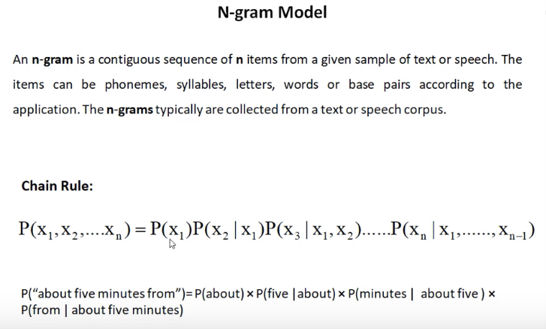

Slide 11
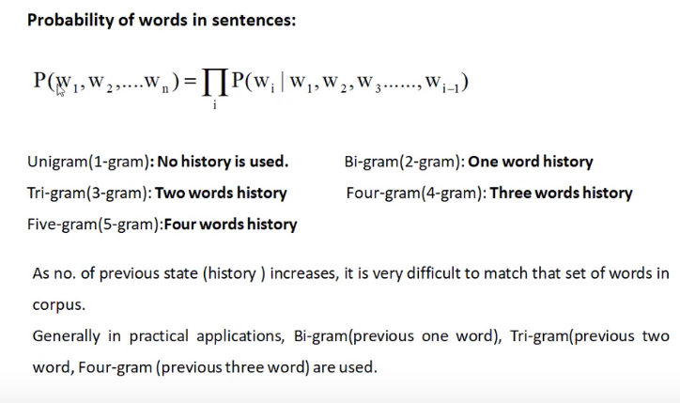
Is the multiplication of probability

Slide 12
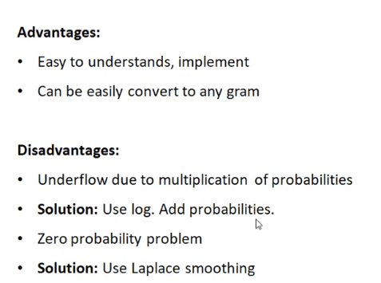

Slide 13
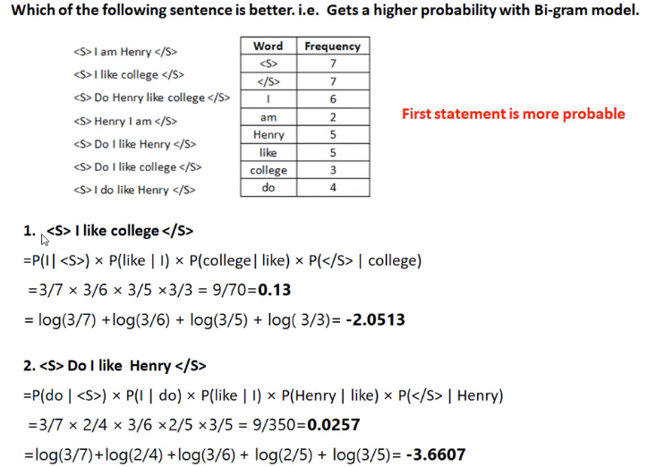

Slide 15
Information retrieval
Information retrieval (IR) may be defined as a software program that deals with the organization, storage, retrieval and evaluation of information from document repositories particularly textual information. The system assists users in finding the information they require but it does not explicitly return the answers of the questions. It informs the existence and location of documents that might consist of the required information. The documents that satisfy user’s requirement are called relevant documents. A perfect IR system will retrieve only relevant documents.
With the help of the following diagram, we can understand the process of information retrieval (IR) −

Slide 16
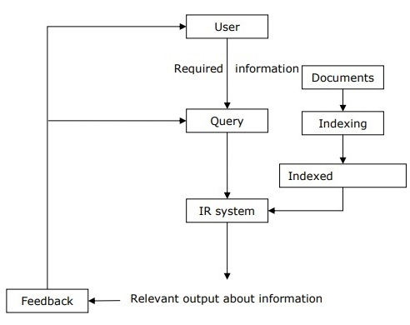
It is clear from the above diagram that a user who needs information will have to formulate a request in the form of query in natural language. Then the IR system will respond by retrieving the relevant output, in the form of documents, about the required information.

Slide 17
Classical Problem in Information Retrieval (IR) System
The main goal of IR research is to develop a model for retrieving information from the repositories of documents. Here, we are going to discuss a classical problem, named ad-hoc retrieval problem, related to the IR system.
In ad-hoc retrieval, the user must enter a query in natural language that describes the required information. Then the IR system will return the required documents related to the desired information. For example, suppose we are searching something on the Internet and it gives some exact pages that are relevant as per our requirement but there can be some non-relevant pages too. This is due to the ad-hoc retrieval problem.

Slide 18
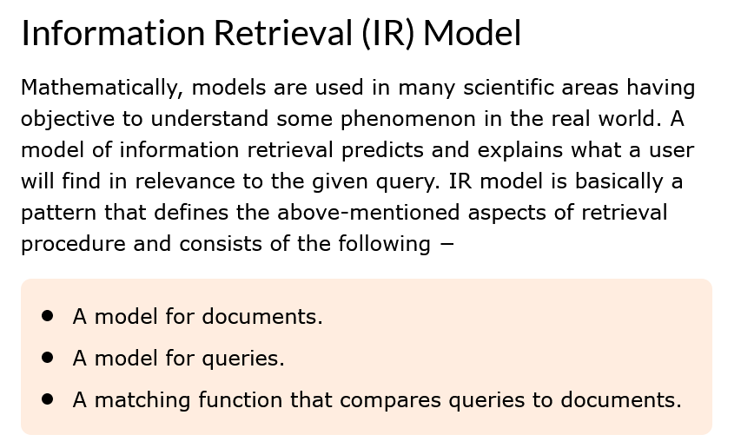
Mathematically, a retrieval model consists of −
D − Representation for documents.
R − Representation for queries.
F − The modeling framework for D, Q along with relationship between them.
R (q,di) − A similarity function which orders the documents with respect to the query. It is also called ranking.

Slide 19
Types of Information Retrieval (IR) Model
An information model (IR) model can be classified into the following three models −
Classical IR Model
It is the simplest and easy to implement IR model. This model is based on mathematical knowledge that was easily recognized and understood as well. Boolean, Vector and Probabilistic are the three classical IR models.
Non-Classical IR Model
It is completely opposite to classical IR model. Such kind of IR models are based on principles other than similarity, probability, Boolean operations. Information logic model, situation theory model and interaction models are the examples of non-classical IR model.
Alternative IR Model
It is the enhancement of classical IR model making use of some specific techniques from some other fields. Cluster model, fuzzy model and latent semantic indexing (LSI) models are the example of alternative IR model.

Slide 20
Types of IR Model
Boolean Expression model
Vector space model

Slide 21
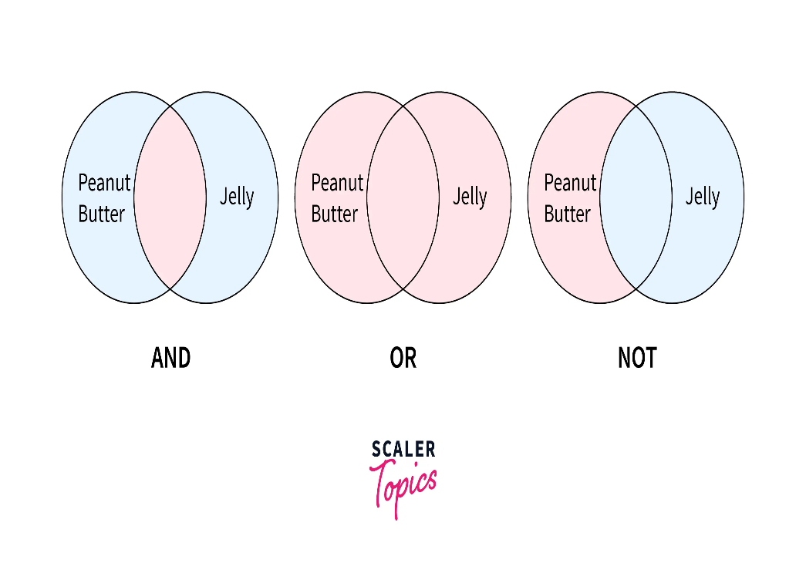
The Boolean model can be defined as −
It is the oldest information retrieval (IR) model. The model is based on set theory and the Boolean algebra, where documents are sets of terms and queries are Boolean expressions on terms
Advantages of the Boolean Mode
The advantages of the Boolean model are as follows −
The simplest model, which is based on sets.
Easy to understand and implement.
It only retrieves exact matches
It gives the user, a sense of control over the system.

Slide 22
Disadvantages of the Boolean Model
The disadvantages of the Boolean model are as follows −
The model’s similarity function is Boolean. Hence, there would be no partial matches. This can be annoying for the users.
In this model, the Boolean operator usage has much more influence than a critical word.
The query language is expressive, but it is complicated too.
No ranking for retrieved documents.

Slide 23
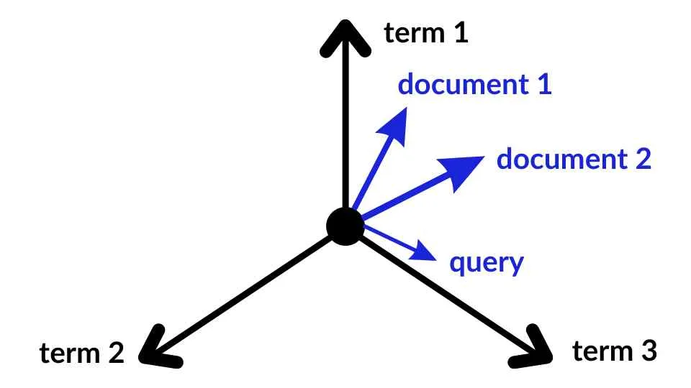
Vector Space Model
Due to the above disadvantages of the Boolean model, Gerard Salton and his colleagues suggested a model, which is based on Luhn’s similarity criterion.
Vector space model or term vector model is an algebraic model for representing text documents (and any objects, in general) as vectors of identifiers (such as index terms). It is used in information filtering, information retrieval, indexing and relevancy rankings. Its first use was in the SMART Information Retrieval System.
The similarity criterion formulated by Luhn states, “the more two representations agreed in given elements and their distribution, the higher would be the probability of their representing similar information.”

Slide 24
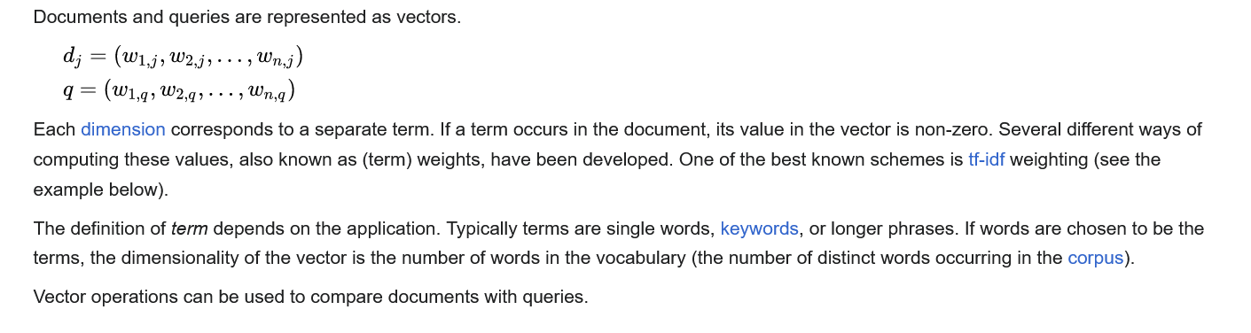
Definition

Slide 25
Application
Relevance rankings of documents in a keyword search can be calculated, using the assumptions of document similarities theory, by comparing the deviation of angles between each document vector and the original query vector where the query is represented as a vector with same dimension as the vectors that represent the other documents.

Slide 26
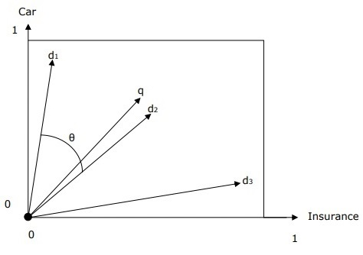
Vector Space Representation with Query and Document
The query and documents are represented by a two-dimensional vector space. The terms are car and insurance. There is one query and three documents in the vector space.

Slide 27
The top ranked document in response to the terms car and insurance will be the document d₂ because the angle between q and d₂ is the smallest.
The reason behind this is that both the concepts car and insurance are salient in d₂ and hence have the high weights. On the other side, d₁ and d₃ also mention both the terms but in each case, one of them is not a centrally important term in the document.

Slide 28
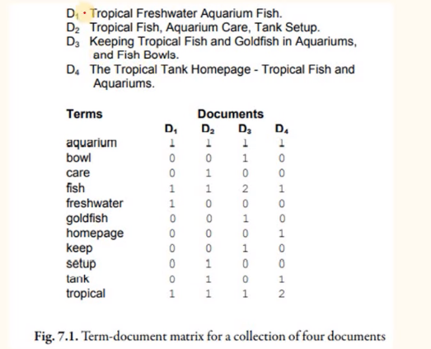

Slide 29
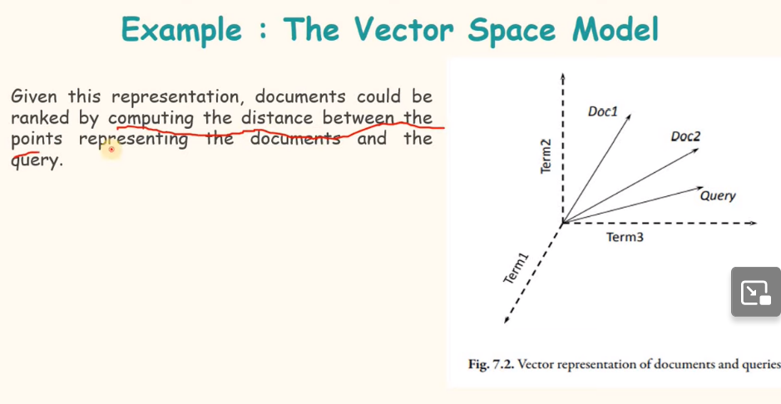

Slide 30
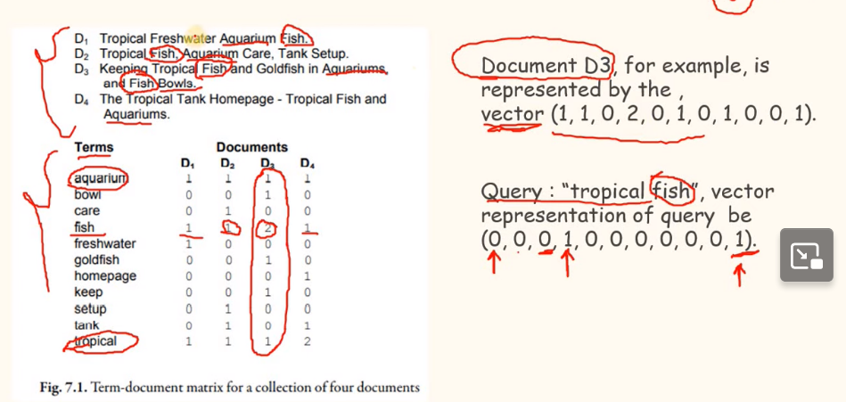

Slide 31
Term Frequency-Inverse Document Frequency
TF-IDF stands for Term Frequency Inverse Document Frequency of records. It can be defined as the calculation of how relevant a word in a series or corpus is to a text. The meaning increases proportionally to the number of times in the text a word appears but is compensated by the word frequency in the corpus (data-set).

Slide 32
Smoothing in NLP
Now, we predict the next words based on training data, which has complete sentences so that the model can understand the pattern for prediction.
Naturally, we have so many combinations of words possible. It is next to impossible to include all the varieties in training data so that our model can predict accurately on unseen data. So, here comes Smoothing to the rescue
Smoothing refers to the technique we use to adjust the probabilities used in the model so that our model can perform more accurately and even handle the words absent in the training set..

Slide 33
Types of Smoothing in NLP
1. Laplace / Add-1 Smoothing Here, we simply add 1 to all the counts of words so that we never incur 0 value. P_{Laplace}(w_{i} | w_{(i-1)}) = (count(w_{i} w_{(i-1)}) +1 ) / (count(w_{(i-1)}) + V) Where V= total words in the training set, 9 in our example. So, P(“I like mathematics”)
= P( I | <S>)*P( like | I)*P( mathematics | like)*P(<E> | mathematics)
= ((1+1) / (3+9)) * ((1+1) / (1+9)) * ((0+1) / (1+9)) * ((1+1) / (3+9))
= 1 / 1800
2.Additive Smoothing It is very similar to Laplace smoothing. Instead of 1, we add a δ value. So, P_{Additive}(w_{i} | w_{(i-1)}) = (count(w_{i} w_{(i-1)}) + δ) / (count(w_{(i-1)}) + δ|V|)

Slide 34
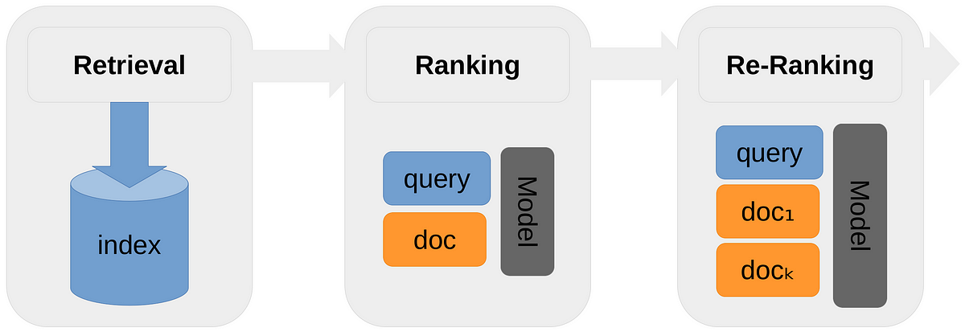
What is the relevance ranking algorithm?
Relevance ranking is a core problem of Information Retrieval which plays a fundamental role in various real world applications, such as search engines. Given a query and a set of candidate text documents, relevance ranking algorithms determine how relevant each text document is for the given query.

Slide 35
Ranking algorithms are used to rank items in a dataset according to some criterion. Ranking algorithms can be divided into two categories: deterministic and probabilistic.
Ranking algorithms are used in search engines to rank webpages according to their relevance to a user’s search query. In

Slide 36
Deterministic ranking algorithms: A deterministic ranking algorithm is one in which the order of the items in the ranked list is fixed and does not change, regardless of the input data. An example of a deterministic ranking algorithm is the rank-by-feature algorithm. In this algorithm, each item is assigned a rank based on its feature value. The item with the highest feature value is assigned a rank of 1, and the item with the lowest feature value is assigned a rank of N, where N is the number of items in the dataset

Slide 37
Probabilistic ranking algorithms: In a probabilistic ranking algorithm, the order of the items in the ranked list may vary, depending on the input data. An example of a probabilistic ranking algorithm is the rank-by-confidence algorithm. In this algorithm, each item is assigned a rank based on its confidence value. The item with the highest confidence value is assigned a rank of 1, and the item with the lowest confidence value is assigned a rank of N, where N is the number of items in the dataset.
Bayesian Ranking Algorithm: A Bayesian ranking algorithm is a probabilistic ranking algorithm that uses a Bayesian network to calculate the item’s relevance score. The Bayesian network is a graphical model that represents a set of random variables and their conditional dependencies.

Slide 38
Log-linear Model Ranking Algorithm: A log-linear model ranking algorithm is a probabilistic ranking algorithm that uses a log-linear model to calculate the item’s relevance score.
One of the most common applications of ranking algorithms is in search engines. Search engines use ranking algorithms to determine which webpages are most relevant to a user’s search query. Ranking algorithms are also used in recommendation systems to recommend items that a user may be interested in

Slide 39
Google Ranking Algorithm: Google’s ranking algorithm is a secret, but we know that it is a probabilistic ranking algorithm. Google uses a variety of factors to rank webpages, including the number of links to a page, the page’s PageRank, and the relevance of the search query to the page.
Amazon Ranking Algorithm: Amazon’s ranking algorithm is also a probabilistic ranking algorithm. Amazon uses a variety of factors to rank items, including the number of reviews an item has, the average rating of an item, and the price of an item

Slide 40
Facebook Ranking Algorithm: Facebook’s ranking algorithm is a secret, but we know that it is a probabilistic ranking algorithm. Facebook uses a variety of factors to rank news stories, including the number of likes, shares, and comments a story has, the story’s PageRank, and the relevance of the story to the user’s News Feed.
Twitter Ranking Algorithm: Twitter’s ranking algorithm is also a probabilistic ranking algorithm. Twitter uses a variety of factors to rank tweets, including the number of retweets, favorites, and replies a tweet has, the tweeter’s PageRank, and the relevance of the tweet to the user’s timeline.

Slide 41
Ranking algorithms are used to rank items in a dataset according to some criterion. There are many different types of ranking algorithms, each with its own set of advantages and disadvantages. Ranking by similarity, distance, preference, and probability are the most common types of ranking algorithms. Ranking by probability is the most accurate type of ranking algorithm because it takes into account the uncertainty of the data

Slide 42
PMI
In statistics, probability theory and information theory, pointwise mutual information (PMI),or point mutual information, is a measure of association. It compares the probability of two events occurring together to what this probability would be if the events were independent.
PMI (especially in its positive pointwise mutual information variant) has been described as "one of the most important concepts in NLP", where it "draws on the intuition that the best way to weigh the association between two words is to ask how much more the two words co-occur in [a] corpus than we would have a priori expected them to appear by chance.

Slide 43
What is Pointwise mutual information?
PMI helps us to find related words. In other words, it explains how likely the co-occurrence of two words than we would expect by chance. For example the word "Data Science" has a specific meaning when these two words "Data" and "Science" go together. Otherwise meaning of these two words are independent. Similarly "Great Britain" is meaningful since we know the word "Great" can be used with several other words but not so relevant in meaning like "Great UK, Great London, Great Dubai etc."

Slide 44
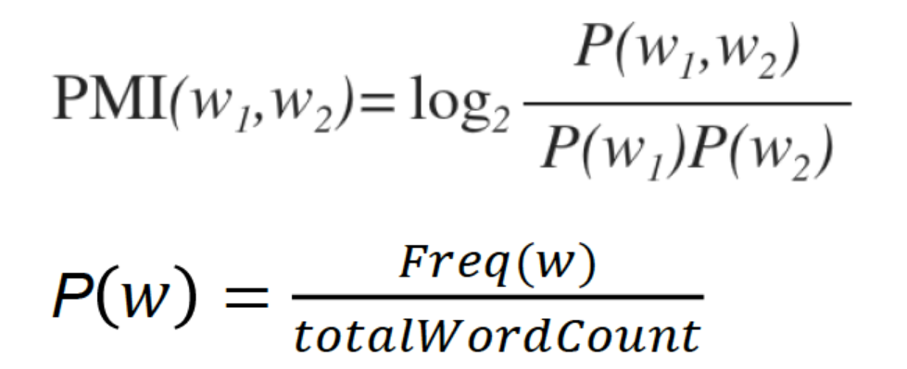
When words 'w1' and 'w2' are independent, their joint probability is equal to the product of their individual probabilities. Imagine when the formula of PMI as shown below returns 0, it means the numerator and denominator is same and then taking log of 1 produces 0. In simple words it means the words together has NO specific meaning or relevance

Slide 45
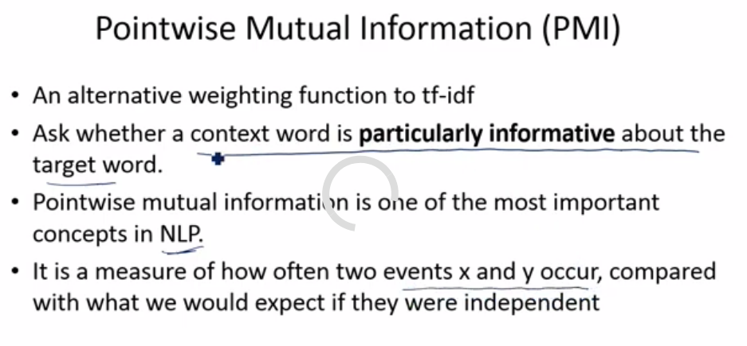

Slide 46
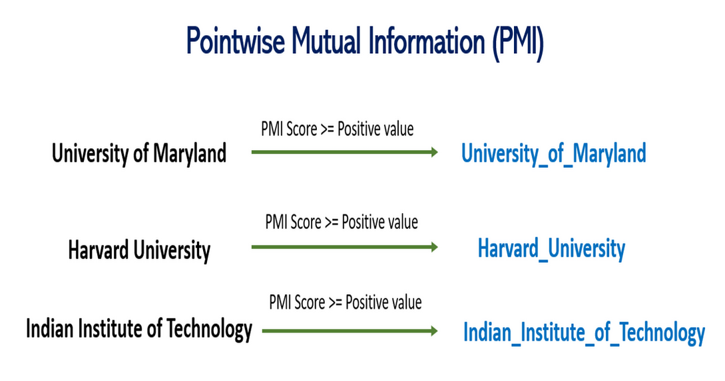

Slide 47
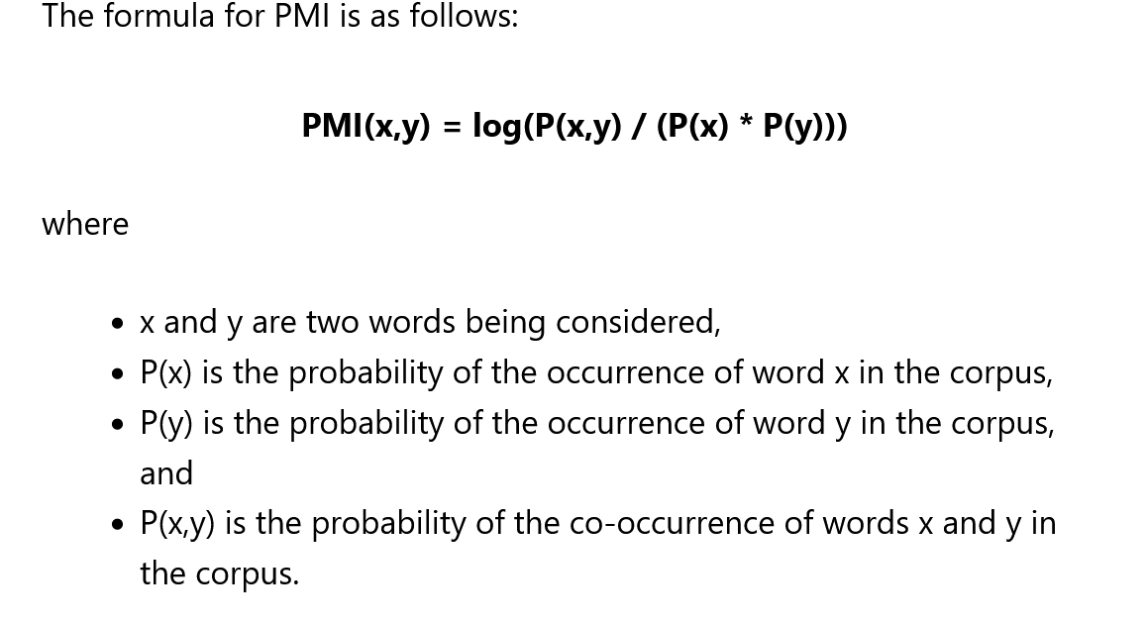

Slide 48
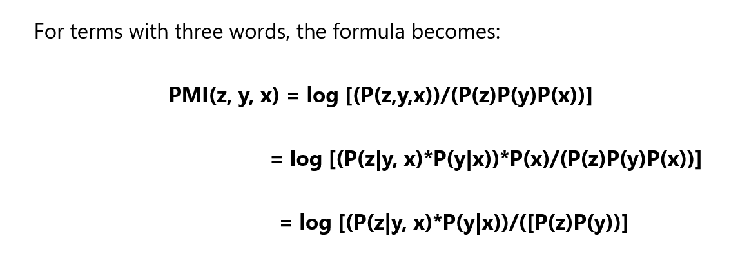

Slide 49
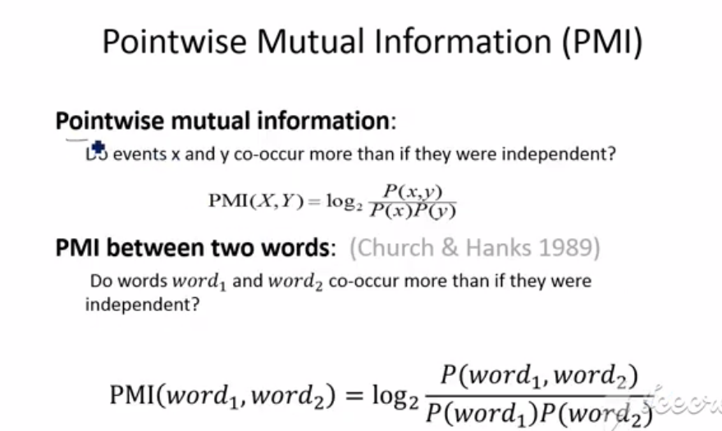

Slide 50
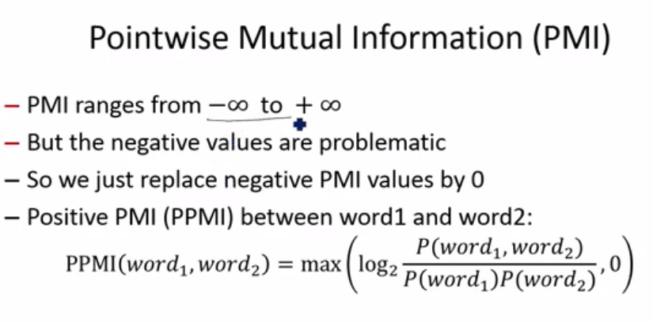

Slide 51
Unit 3: Sequence Labeling
Text Preprocessing,
Context-Free Grammars,
Part-of-speech tagging,
HMM Tagging,
CRF, Named entity recognition,
Evaluation of Named Entity Recognition.
Syntax and Parsing,
Parsing techniques: dependency parsing, constituency parsing,
Maximum Entropy Markov Models.

Slide 52

Unit 4: Text Classification and Sentiment Analysis
Classifiers for text classification and sentiment analysis,
Optimizing Sentiment Analyzer,
Other text classification tasks and the Language Model,
Text Classification with Logistic Regression Model,
Multinomial logistic regression,
Cross-entropy loss function,
Gradient Descent,
Regularization,
Interpreting model.

Slide 53
Unit 5: Deep Learning for NLP Applications
Simple Recurrent Networks, Applications of RNNs, Deep Networks: Stacked and Bidirectional RNNs, Managing Context in RNNs: LSTMs and GRUs, The Encoder-Decoder Model with RNNs, Words, Characters and Byte-Pairs, Transformers and Pretrained Language Models, Fine-Tuning and Masked Language Models
CASE STUDY: ChatGPT, GPT, AI Powered Tools, Sentiment Classification, Dialog Systems, Chatbots, Movie review system, Text Summarization, Language Translation, Question Answering and Information Retrieval, Automatic Speech Recognition, Text-to-Speech Conversion, Speech to Text Conversion

Slide 54
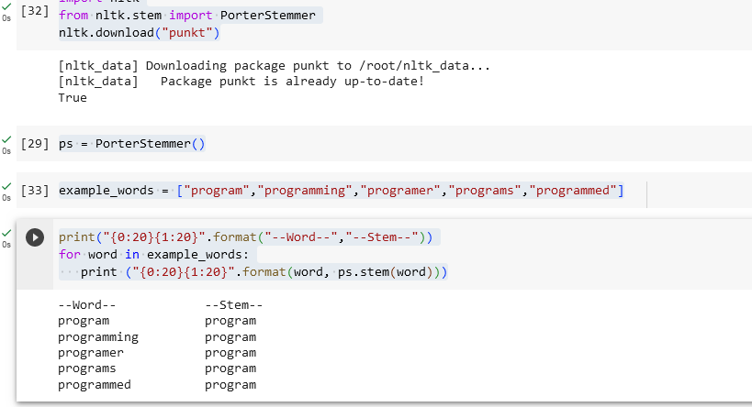
4. Perform Lemmatization and Stemming. Identify parts-of Speech using Penn Treebank tag set.
Stemming
4 | Unit 3 | Perform Lemmatization and Stemming. Identify parts-of Speech using Penn Treebank tag set.

Slide 55
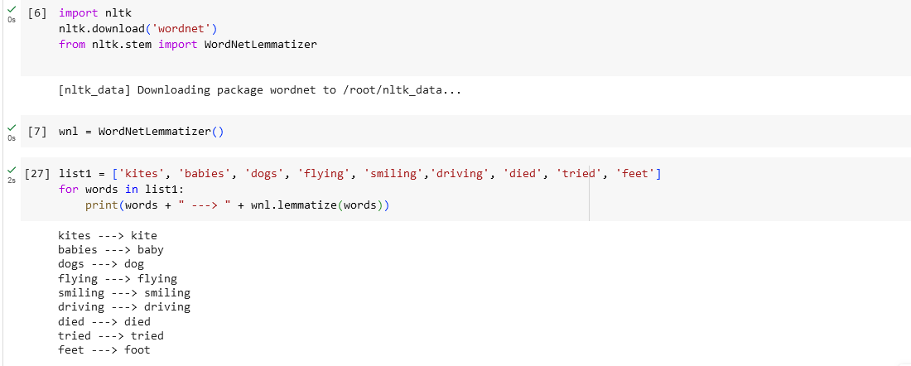
Lemmatization
https://www.datacamp.com/tutorial/stemming-lemmatization-python

